Slide 1


Department of Computer Science and Engineering
Automated Android Malware Detection
John Praveen J 211420104113
Kiran M P 211420104132
Prabaakaran C M 211420104196
Mr.A.N Sasikumar
Assistant Proffessor (Grade I)
Dr.G.Senthilkumar
Associate Proffessor

Slide 2
Introduction
In the realm of cybersecurity, the proliferation of Android malware presents a formidable challenge, necessitating innovative solutions. Leveraging machine learning techniques offers a promising avenue to detect and mitigate these threats effectively. By analyzing patterns and anomalies within app behavior, machine learning algorithms can discern malicious intent. Feature engineering plays a crucial role in extracting relevant attributes from Android applications for model training. Supervised learning methods like Support Vector Machines and Neural Networks are commonly employed for malware detection. Unsupervised learning techniques, including clustering, aid in identifying novel threats without labeled data. Transfer learning and ensemble methods further enhance model robustness and adaptability. Performance evaluation metrics gauge the effectiveness and efficiency of detection systems. Despite progress, challenges persist, signaling the need for ongoing research and development to fortify Android security.

Slide 3
Objective of the Project
The objective of this study is to develop a prevention mechanism for malicious calls without relying on specific telephony network infrastructure. It aims to collect effective information through Machine Learning Algorithms, utilizing consumer data to classify calls into telemarketing, Unwanted (Malicious), and rob calls.

Slide 4
Literature Survey
s.no | Year | Title | Author | Technics
1 | 2019 | Title: Software defectprediction techniques using metrics based on neuralnetwork classifiers. Cluster Computing, 22(1), pp.77-88. | Jayanthi, R. and Florence, L. | Software industriesstrive forsoftwarequality improvement by consistent bug prediction, bug removal andprediction of fault-prone module.
2 | 2017 | Integrated approach to software defect prediction. IEEE Access, 5, pp.21524-21547. | Felix, E.A. and Lee, S.P | Software defect predictionprovides actionable outputs to software teams while contributing to industrial success.
3 | 2015 | Multiple kernel ensemble learning for software defect prediction. Autom. Softw. Eng. 23, 569–590 | Wang, T., Zhang, Z., Jing, X., Zhang, L. | Software defect prediction aims to predict the defect proneness of new software modules with the historical defect data so as to improve the quality of a software system.

Slide 5
Existing System
The majority of people across the globe rely on telephony networks as their primary means of communication. As such, many of the most sensitive personal, corporate and government related communications pass through these systems every day. Unsurprisingly, such connections are subject to a wide range of attacks. Of increasing concern is the use of metadata contained in Call Detail Records (CDRs), which contain source, destination, start time and duration of a call.

Slide 6
Proposed System
• First, we are preprocessing the data and splitting as a two part. One is a training and test part. Then what are the features we need from dataset, we are selecting that attributes.
• Then we are applying the classification technique using machine learning boosting algorithm.
• At last we are finding the result as accuracy and confusion matrix results.
• Then getting AoC and RoC accuracy.

Slide 7
Software / Hardware Requirements
Hardware:
OS – Windows 7,8,11
RAM – 4GB
Software:
Python IDLE
Anaconda
VS Code

Slide 8
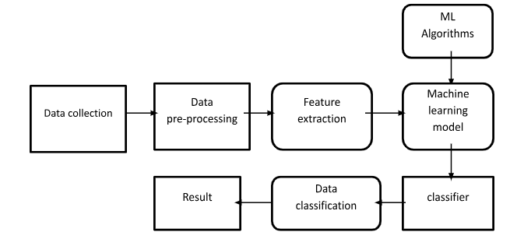
System Architecture

Slide 9
System Implementation
COLLECTION OF DATA
PRE-PROCESSING THE DATA
EXTRACTION OF FEATURES
EVALUATING THE MODEL

Slide 10


Result
Login page & Main Page

Slide 11
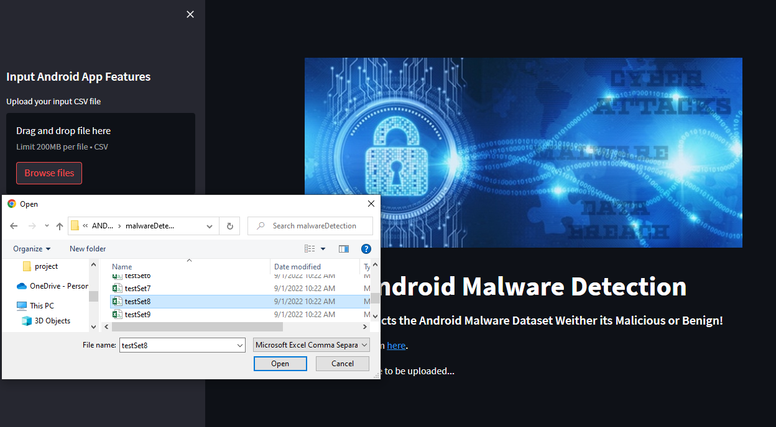
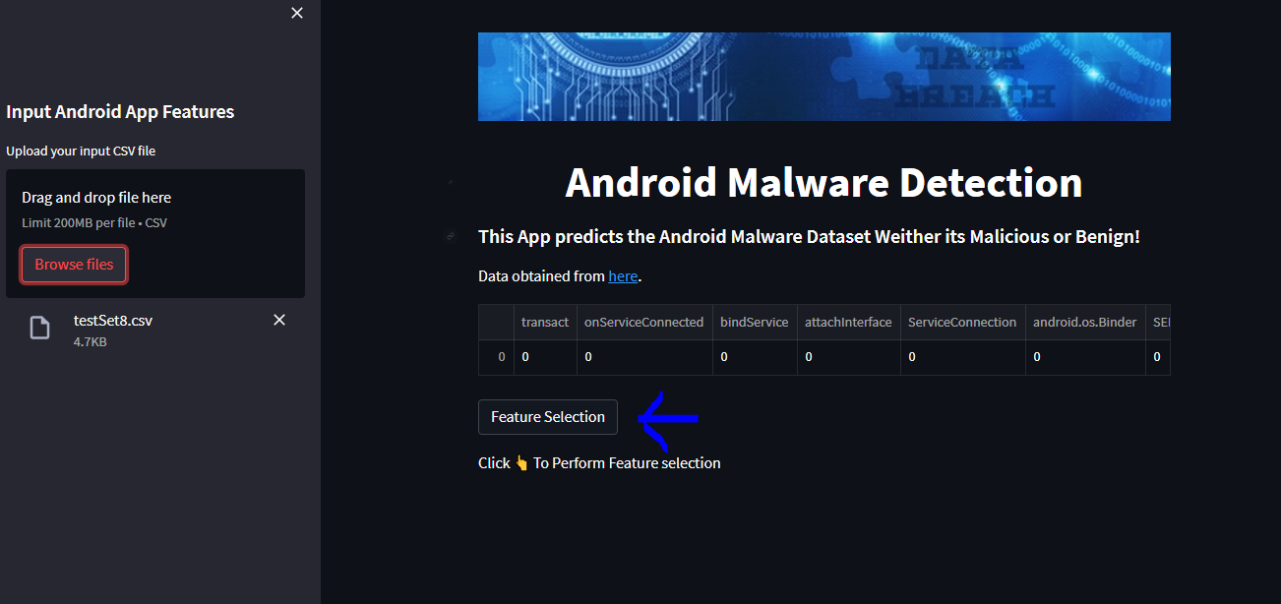
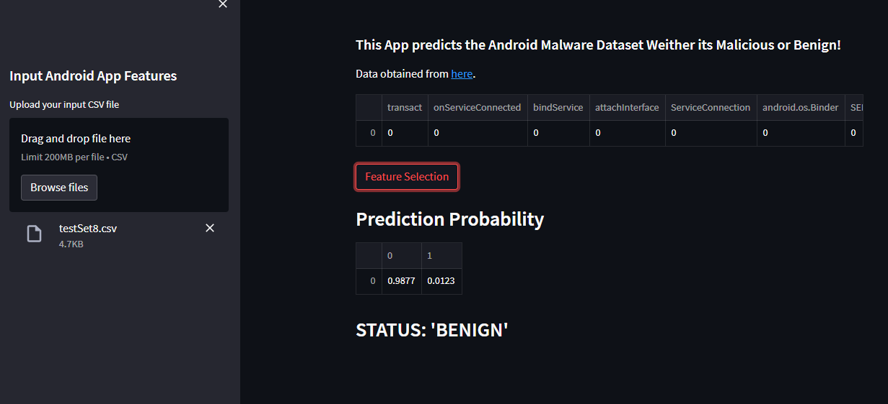
Testcase,Feature Selection and Output

Slide 12
Conclusion
This study highlights the significance of utilizing Machine Learning Algorithms to combat malicious calls, safeguarding privacy and security in telephony networks. By collecting and analyzing consumer data, an effective prevention mechanism can be developed to classify calls accurately, ultimately enhancing trust and reliability in communication systems.

Slide 13
References
[1] Jayanthi, R. and Florence, L., 2019. Software defect prediction techniques using metrics based on neural network classifiers. Cluster Computing, 22(1), pp.77-88.
[2] Felix, E.A. and Lee, S.P., 2017. Integrated approach to software defect prediction. IEEE Access, 5, pp.21524-21547.
[3] Wang, T., Zhang, Z., Jing, X., Zhang, L.: Multiple kernel ensemble learning for software defect prediction. Autom. Softw. Eng. 23, 569–590 (2015).
[4] Xu, Z., Xuan, J., Liu, J., Cui, X.: MICHAC: defect prediction via feature selection based on maximal information coefficient with hierarchical agglomerative clustering. In: 2016 IEEE 23rd International Conference on Software Analysis, Evolution, and Reengineering (SANER), Suita, pp. 370–381 (2016).
[5] Ryu, D., Baik, J.: Effective multi-objective naïve Bayes learning for cross-project defect prediction. Appl. Soft Comput. 49, 1062 (2016).

